Slide 1
Vehicle Intrusion Detection using open-cv (python 3.6x) and deep learning
Karthik Vakkalagadda
Kavya manubarthi
Ravindra
Balaji
Guided by – Sekhar.ch

Slide 2
Problem statement
Vehicle intrusion detection A.K.A VID is a enhancement to existing security system which enables the use of conventional computer vision to identify the unauthorized vehicles which are trying to bypass through security system

Slide 3
Solution using computer vision
Computer vision provides huge advantage for Vehicles Intrusion detection by
emulating the striking perceptual capability of human eye . We can break down a video into set of frames and then we can perform our computation on frames of the input video

Slide 4
Suitable for deployment In
Military base
Security check depo’s
Government quarters
Nuclear research bases
Restricted zones

Slide 5
Technologies required for development
Python 3.6x
Openpyxl
Pymysql
SMTP python
OpenCV
Tensor flow
Multithreading
Deep learning algorithms
Webcam

Slide 6
OPEN computer vision with Python 3.6x
Computer vision is concerned with the automatic
Extraction, analysis and understanding of useful
information from a single image or a sequence of images.
It involves the development of a theoretical and algorithmic basis to achieve automatic visual understanding

Slide 7
Pymysql framework from python
Pymysql is database framework which can act
as a middle ware between python and it's
associated database
It can perform all the crud operations required on
the table with simpler syntaxes

Slide 8
OPENPYXL framework from python
Open pyxl is open source python framework which can be used to read the pre prepared data from excel sheet which consists structured and consisted data
-It allows to perform all the crud operations on excel sheets

Slide 9
Logging framework from python
-Logging is a key component that is indispensable
for troubleshooting errors especially when the bug has already happened
-Python has a builtin logging package which is used by all major python frameworks

Slide 10
SMTP protocol using python
-SMTP stands for simple mail transfer protocol
-using SMTP we can send messages from a program which is in execution to appropriate email address

Slide 11
Roadmap for development
Development of this project is fragmented to
four different phases
Database creation
Analysis using deep learning
Query processing
Output generation to security

Slide 12
Stage -1: creating authenticated vehicles database
In this stage we manual collect all the
authenticated vehicles numbers
We then use OpenPyXl and Pymysql to import the data into the database

Slide 13
Stage-2: analysis using opencv middleware
This stage is implemented to support two
different modes
Online (with live camera)
Offline (recorded video)
Deep learning algorithms are implemented in python to support both the functionalities

Slide 14
Stage-3:Query processing using multithreading
This stage is implemented to support two
different modes
Online (with live camera)
Offline (recorded video)
Deep learning algorithms are implemented in python to support both the functionalities

Slide 15
Stage-4: Output generation for intrusion on smtp
If it is found that the vehicle is responsible
for intrusion then a snapshot of the vehicle
along with its registered number will be emailed
to the security department
This stage will be multithreaded so that video analysis for the next vehicle wouldn’t be delayed

Slide 16
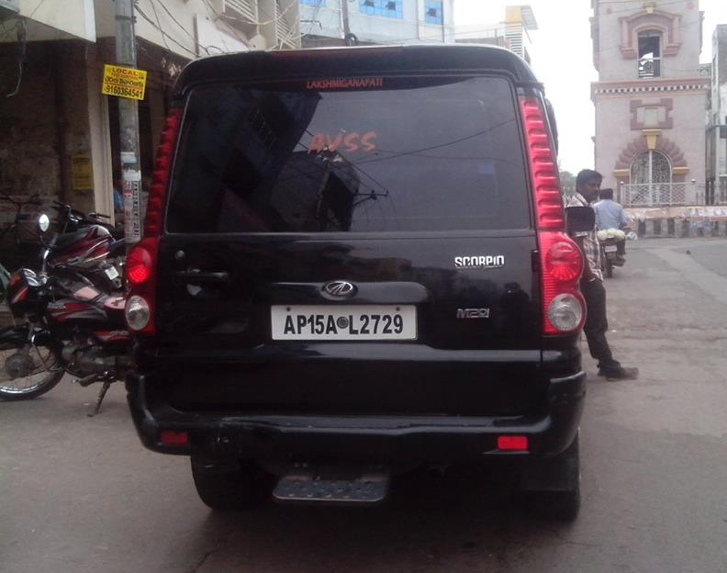
Sample demonstration on authenticated user
Registered person id | Vehicle number
11113 | AP 15 AL 2729
11114 | AP 31 BG 7000
…….. | …….
Authenticated user

Slide 17
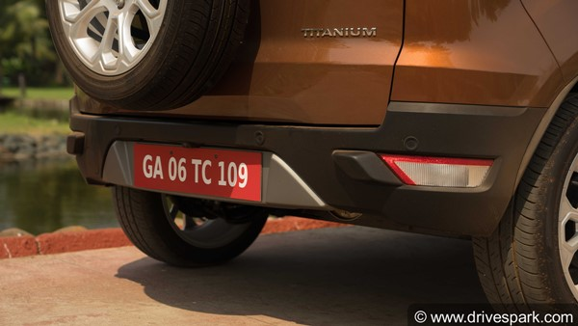
Sample demonstration on intruded user
Registered person id | Vehicle number
11113 | AP 15 AL 2729
11114 | AP 31 BG 7000
…….. | …….
Intrusion detected

Slide 18
Sample demonstration on intruded user part-2
SMTP
Security alert

Slide 19
Courses undertaking for this project and estimated time
Python 3.6x(1 week)
OpenCV ( 2 weeks)
Openpyxl, pymysql (1 week)
Machine learning coursera (1.5 month)
Deep learning coursera (2 months)

Slide 20
Resources for presentation
Google images
Coursera
Wikipedia
Python framework documentations

Slide 21
Thank you

